Slide 1
The Implementation
ER system introduction & issues

Slide 2
ER information system introduction
Brain storm & hope on the horizon
Initializing with the psychologic poll
Emotion indicators v1.0
Emotion indicators v2.0
Applying ranking theory

Slide 3
ER information system introduction
Initializing with the psychologic poll

Slide 4
ER information system introduction
Initializing with the psychologic poll
Top 10
学习压力 / Academic Pressure | 14 |  | 追星/偶像 / Stars & Elites | 7
父母/家庭关系 / Parents, Family Relations | 10 |  | 学业 / Academic Performance | 6
朋友/人际关系 / Firends & Personal Relations | 10 |  | 天气 / Wheather | 5
考试测试 / Tests & Exams | 8 |  | 周边环境 / Physical Environment | 4
恋爱/异性 / Love | 7 |  | 托福成绩 / TOEFL Scores | 4

Slide 5
ER information system introduction
Emotion indicators v1.0
tried a flexible design
Video A: the indicator design pattern

Slide 6
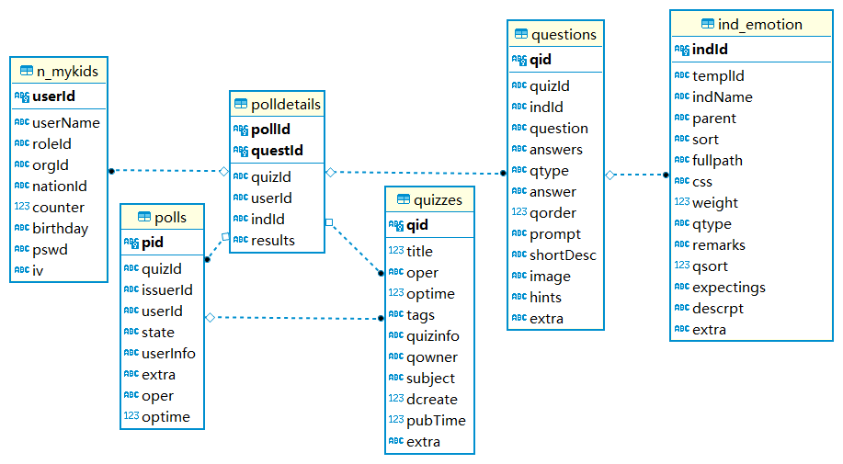
ER information system introduction
Questions
The indicators’ instance
Emotion Index
Poll Subjects
Detailed Answers
The users’ response
Polls
The poll events
Quiz
The combine of questions

Slide 7
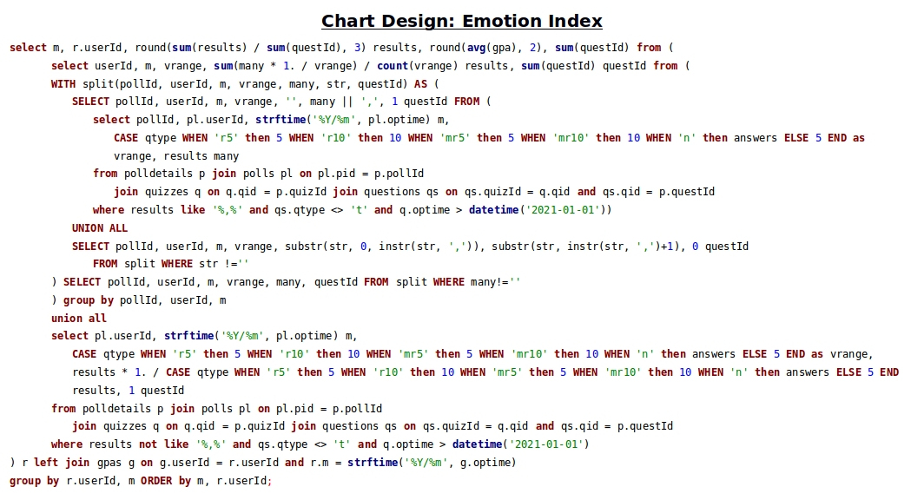

Slide 8
ER information system introduction
Emotion indicators v1.0
so we need a flexible design
Video B: the poll & quiz calculation

Slide 9
ER information system introduction
Emotion indicators v1.0
Results: extremely not user friendly
Too much questions in one quiz
Questions are hardly answerable

Slide 10
ER information system introduction
Emotion indicators v2.0
Changes:
Add & divide the questions into multiple equivalent parts
Keep each quiz has only 8 – 9 questions
Simplify the question types to 1 type: 5 star ranking

Slide 11
ER information system intruduction
Emotion indicators v2.0
Changes:
Divide the questions into multiple equivalent parts
Keep each quiz has only 8 – 9 questions
Simplify the question types to 1 type: 5 star ranking

Slide 12
ER information system introduction
Applying ranking theory
Colley Method & Massey Method

Slide 13
Issues
Data, team, knowledge and more …

Slide 14
Why failed?
A user friendly application is much more expensive than expected
Timeline & the process disappointed everyone
…

Slide 15
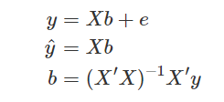
Guessing the future direction
Have the users themselves rank their emotions ( y ).
Multiple Regression Model
where
y = n x 1 column of different emotions labeled by users themselves
ŷ = n x 1 column of predicated y
X = n x k matrix of question weights
b = k x 1 column vector or regression coefficients
e = n x 1 column vector of n residual values

